Slide 1
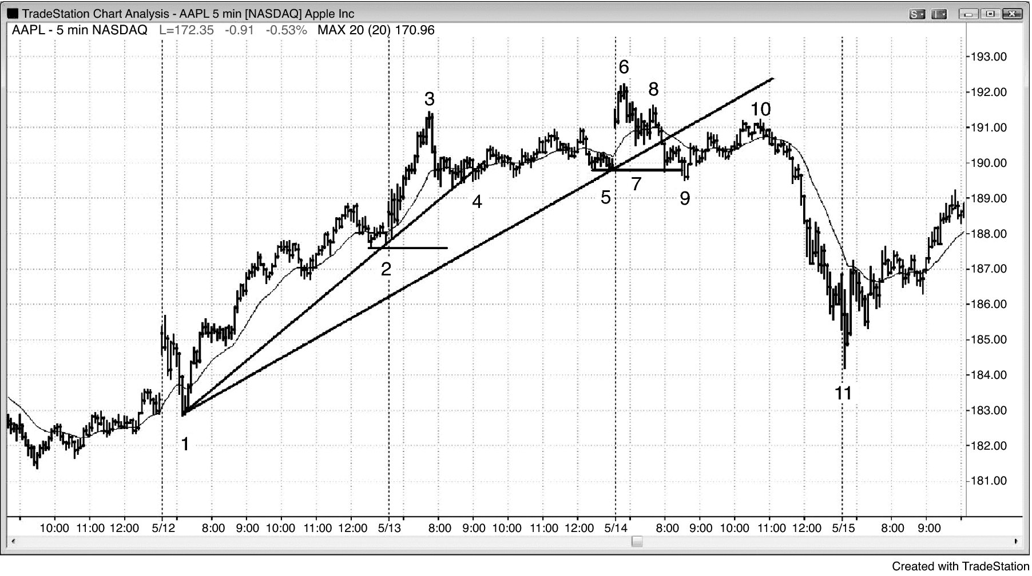
FIGURE 3.1 A Higher High Followed by a Lower High

Slide 2
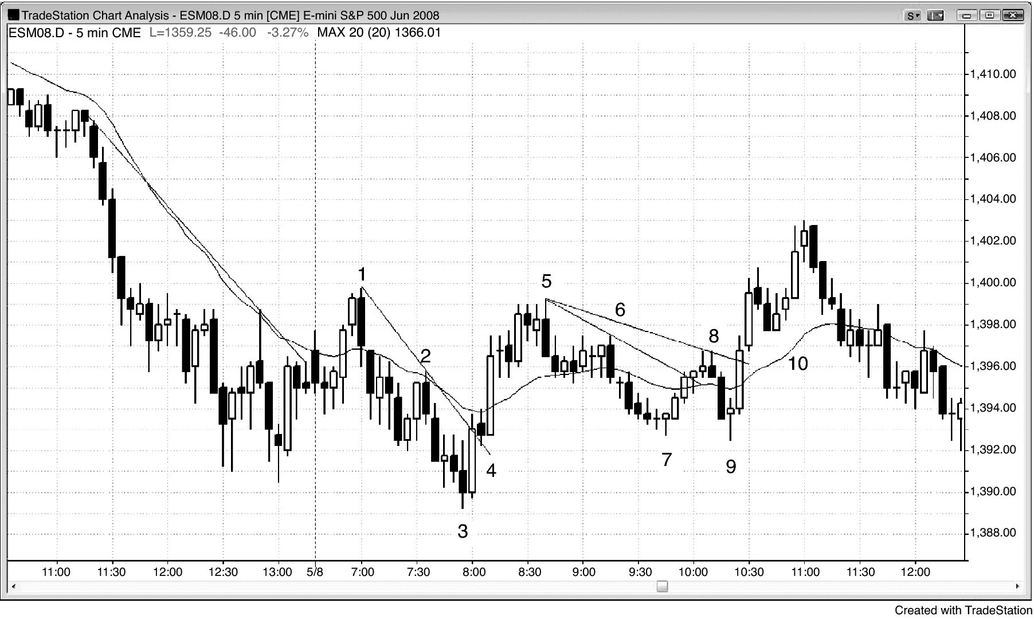
FIGURE 3.2 A Lower Low Followed by a Higher Low

Slide 3
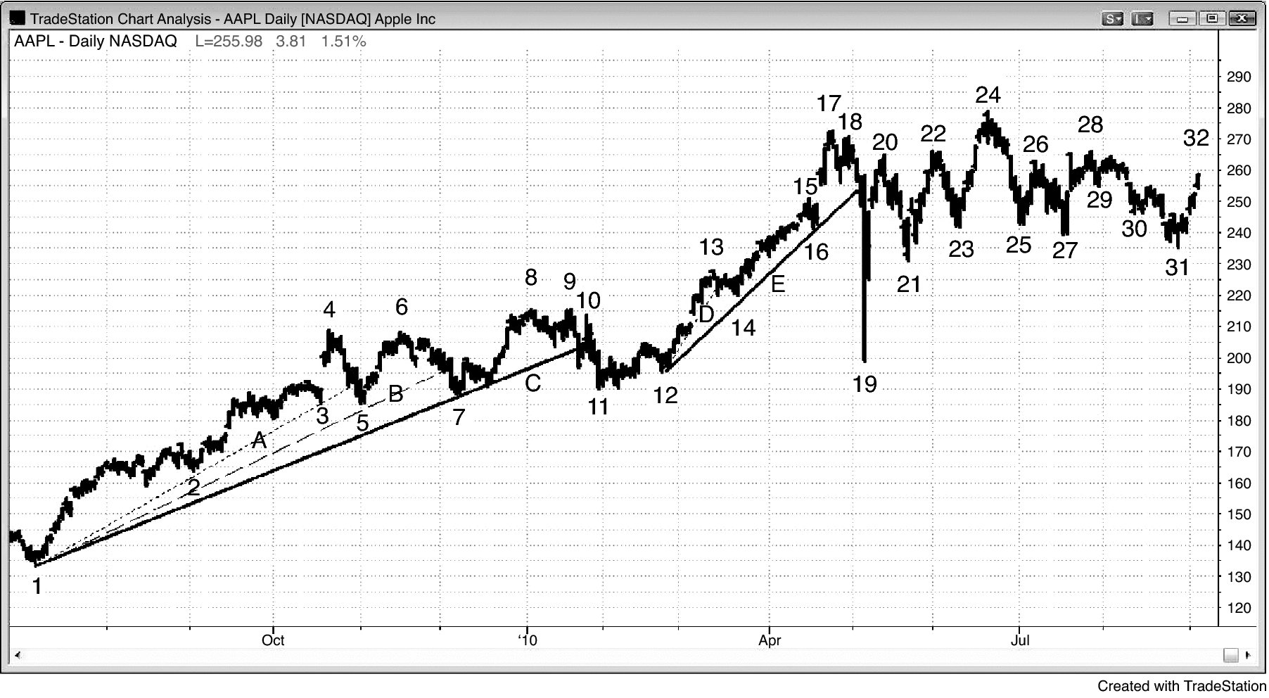
FIGURE 3.3 A Trend Line Break Alone Does Not Make a Reversal

Slide 4
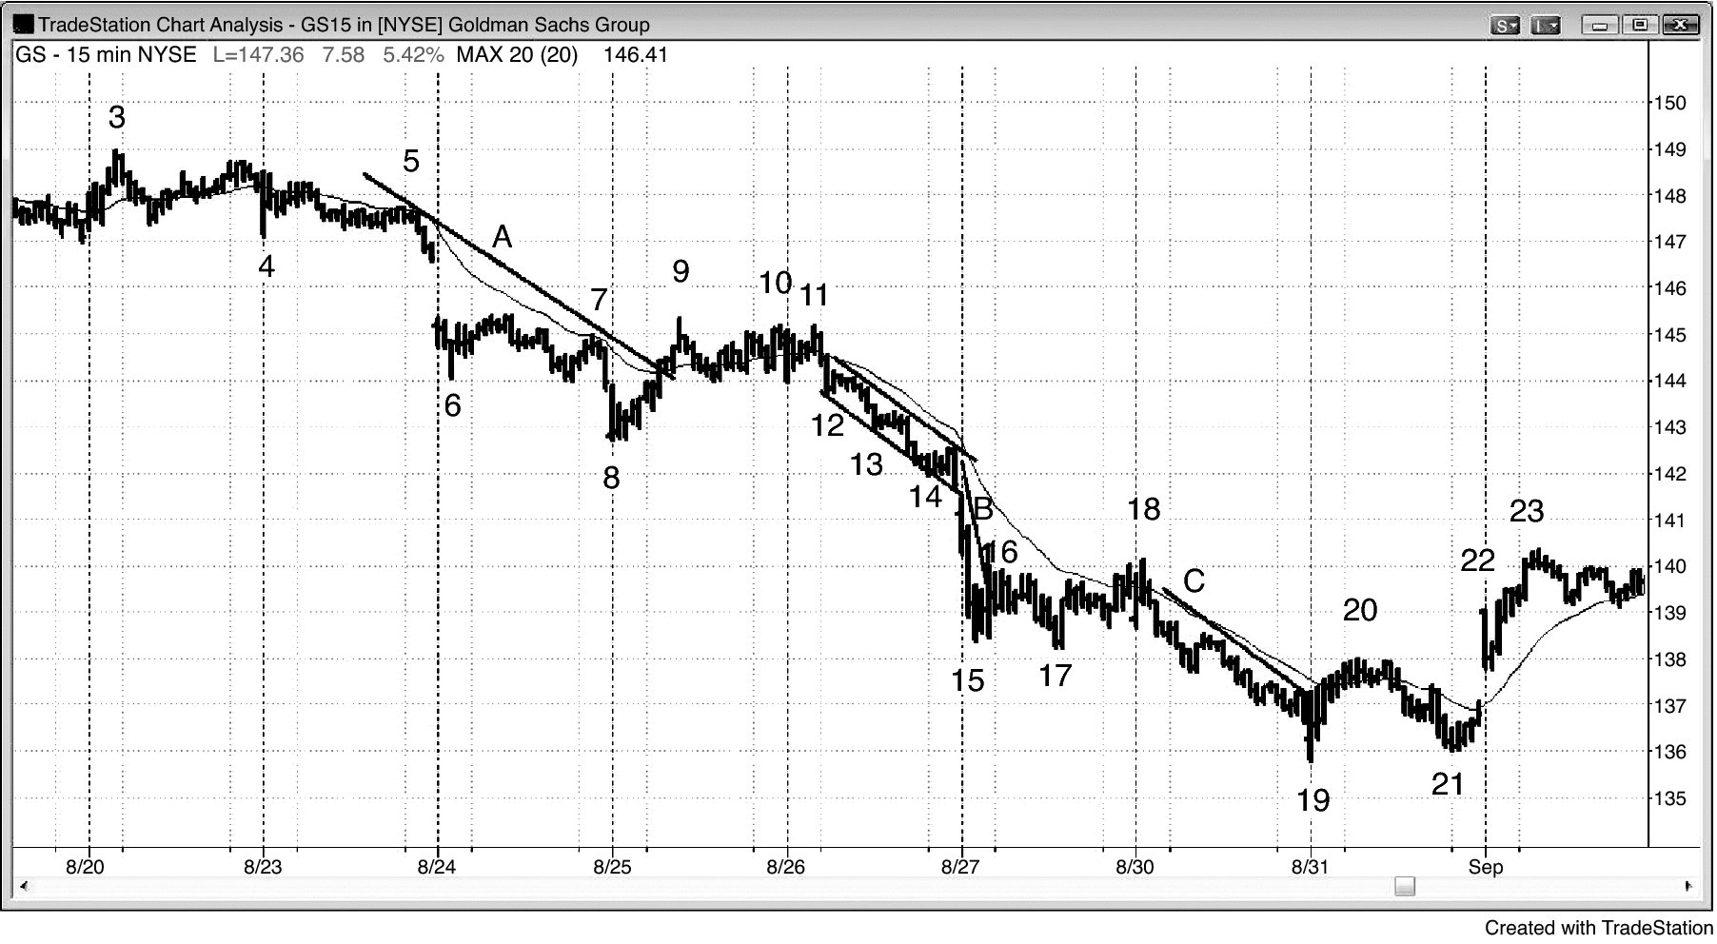
FIGURE 3.4 If a Test Is Too Strong, Wait

Slide 5
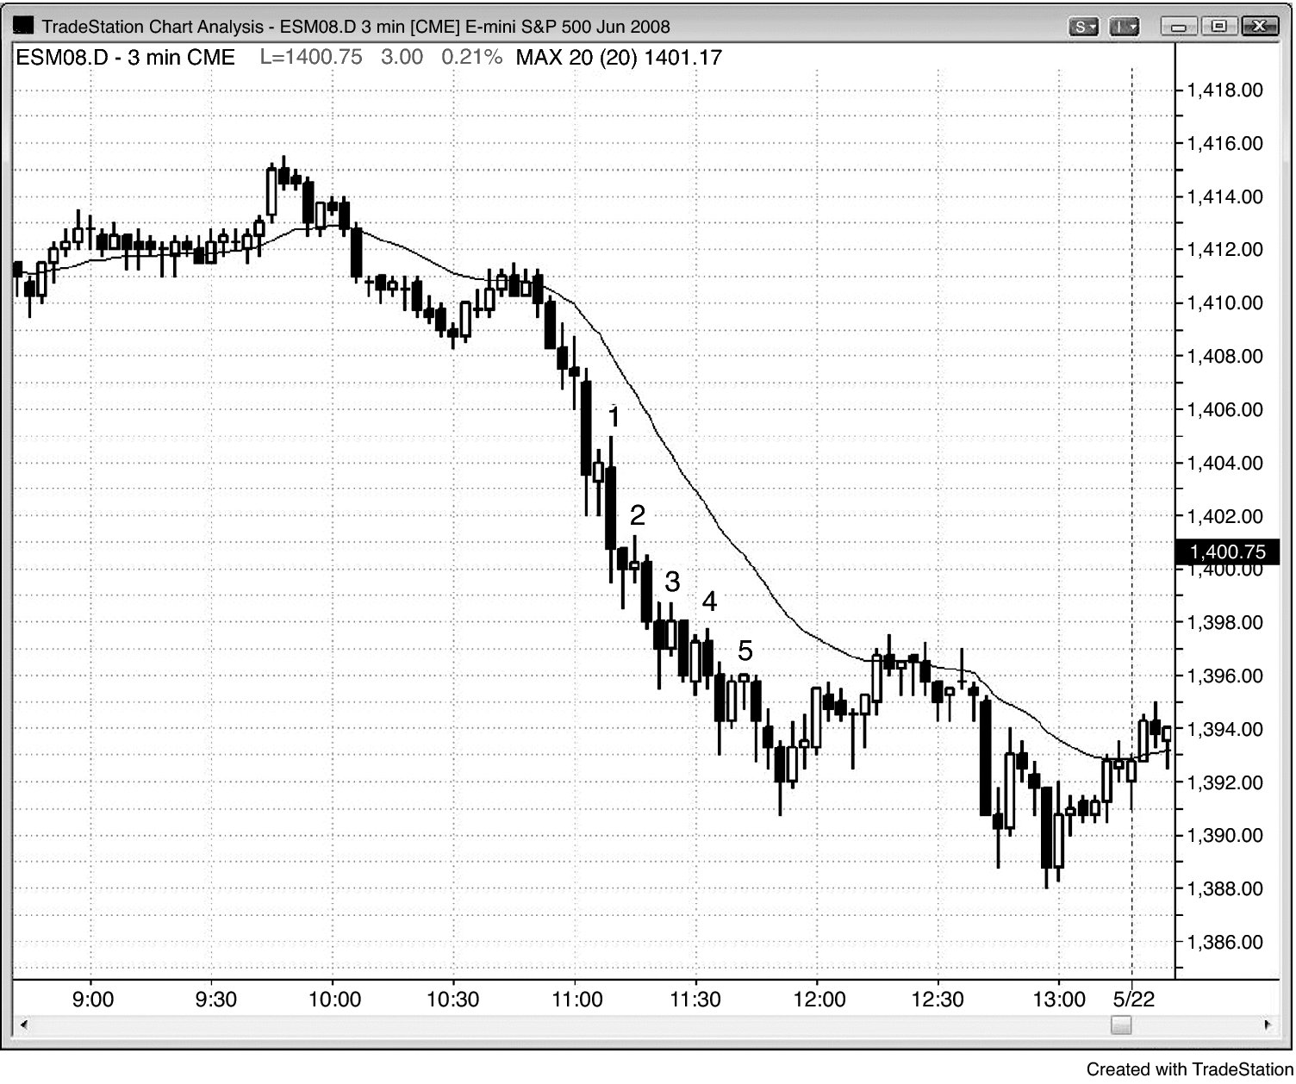
FIGURE 3.5 Don’t Look for Reversals on Smaller Time Frame Charts

Slide 6
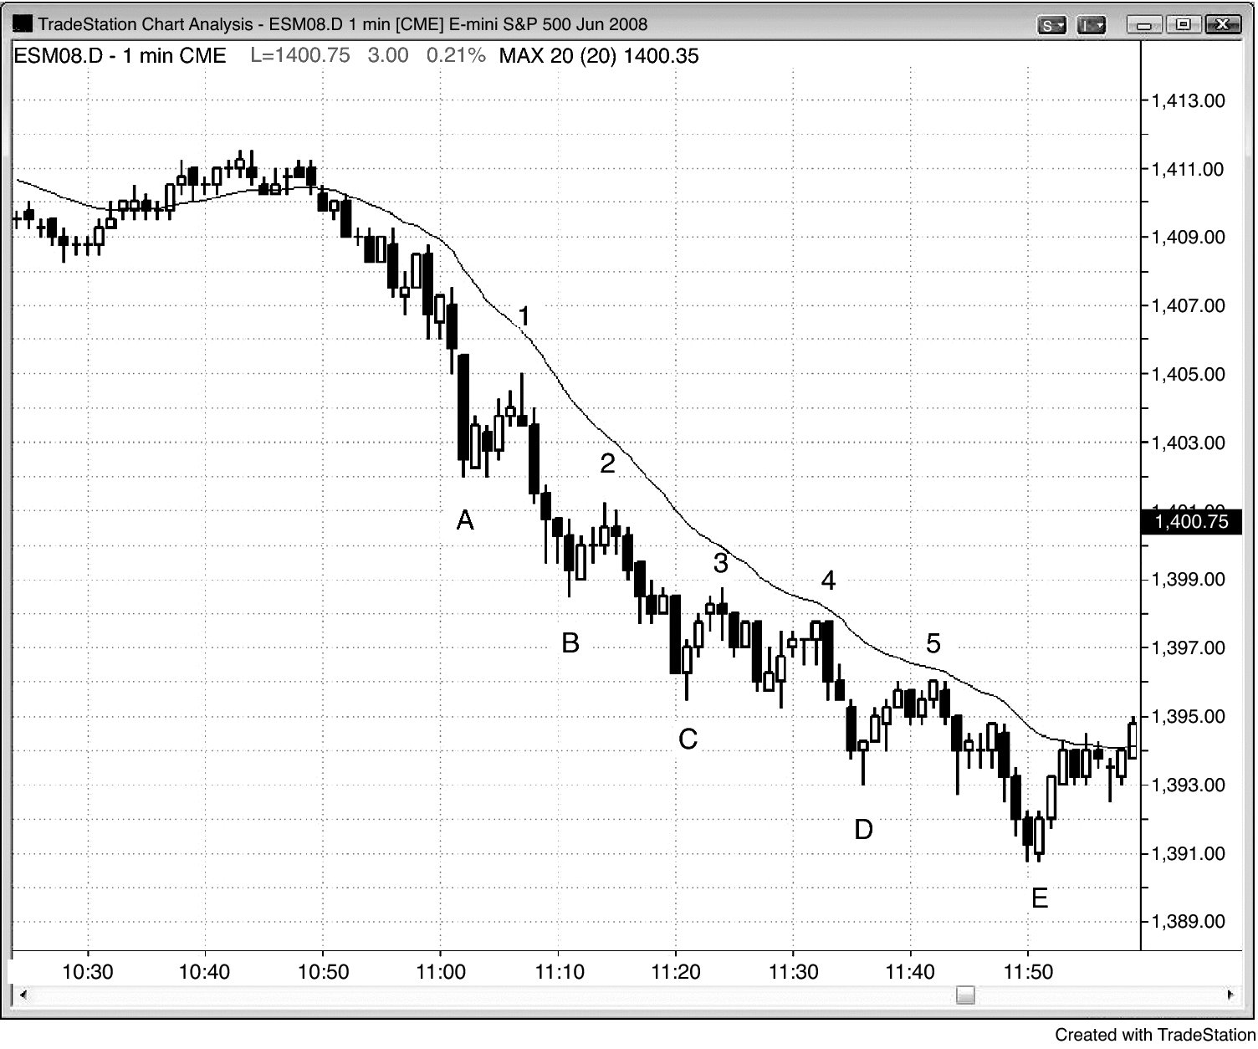
FIGURE 3.6 Smaller Time Frames Are for With-Trend Trading Only

Slide 7
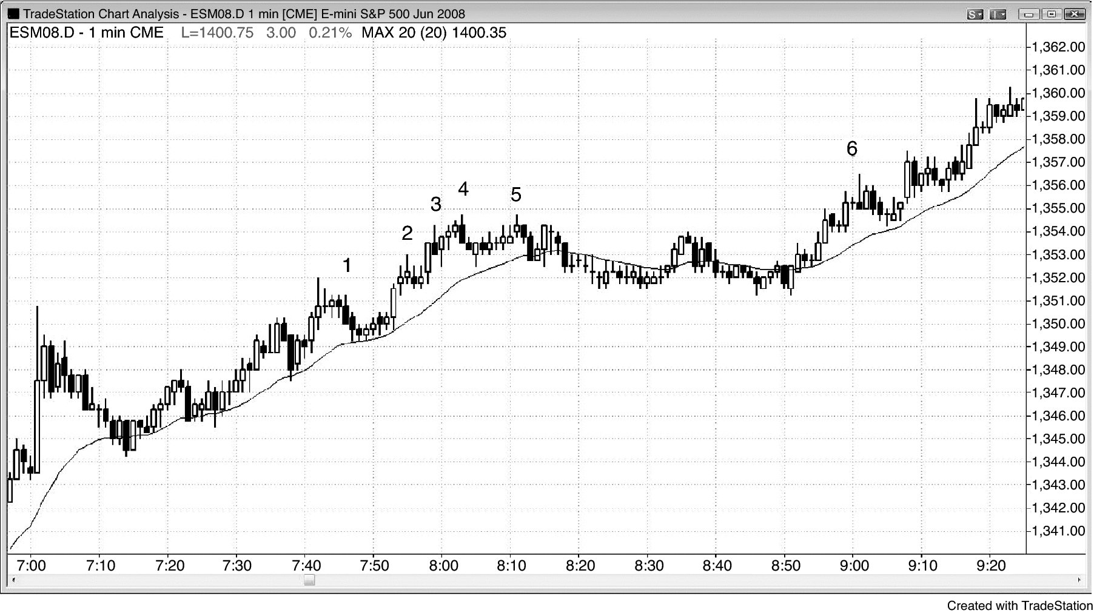
FIGURE 3.7 Smaller Time Frame Reversals Are Losers

Slide 8
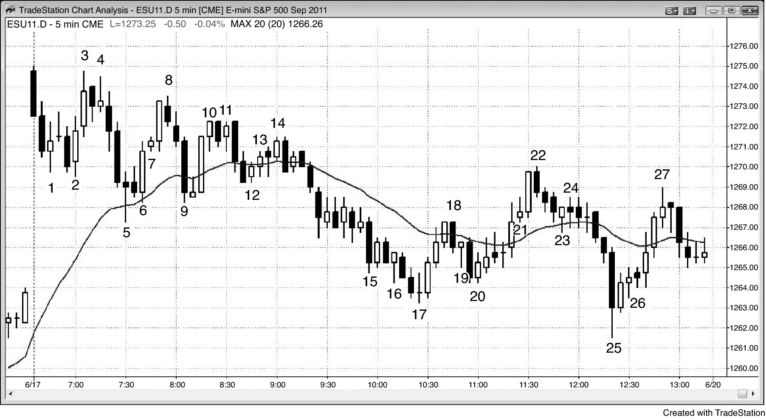
FIGURE 3.8 Micro Double Bottoms and Tops

